Slide 1
Introduction To “R”
CHINMAI SAI SURE
11/06/2019
44-613-Data Visualization

Slide 2
Overview
What is “R”.
Basics of “R”
Data structures of “R”
Reading Data in “R”
Statistical Functions of “R”
Demo of “R” Introduction
Summary of “R”
Chinmai sai Sure

Slide 3
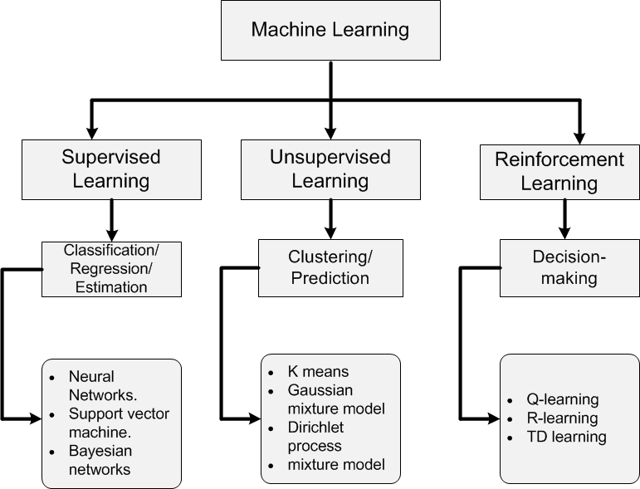
Chinmai sai Sure

Slide 4
What is R
Software for statistical Data Analysis
It is a programming Environment
Interpreted Language
Data storage, Analysis, Graphing
Free and Open source software
Chinmai sai Sure

Slide 5
Basics of “R”
Highly Functional
- Everything done through functions.
- Strict named arguments.
- Abbreviations in arguments OK.
Object Oriented
- Everything is an Object.
- “< - ” is an assignment operator.
Chinmai sai Sure

Slide 6
DATA STRUCTURS
Supports any virtual type of data.
Numbers, Characters, Logicals(TRUE/FALSE).
Arrays of virtually unlimited sizes.
Chinmai sai Sure

Slide 7
In an R session
First, read data from other sources
Use packages, libraries, and functions.
Write functions wherever necessary.
Conduct statistical Data Analysis.
Save Output to files, write tables.
Save R workspace if necessary(exit prompt).
Chinmai sai Sure

Slide 8
Reading data
R not well studied for data processing
Easiest form of data to input: text file
Spread sheet like data:
- Small/medium size: use read.table().
- large data: usescan().
Read from other systems:
- Use the library “foreign”: library(foreign)
Chinmai sai Sure

Slide 9
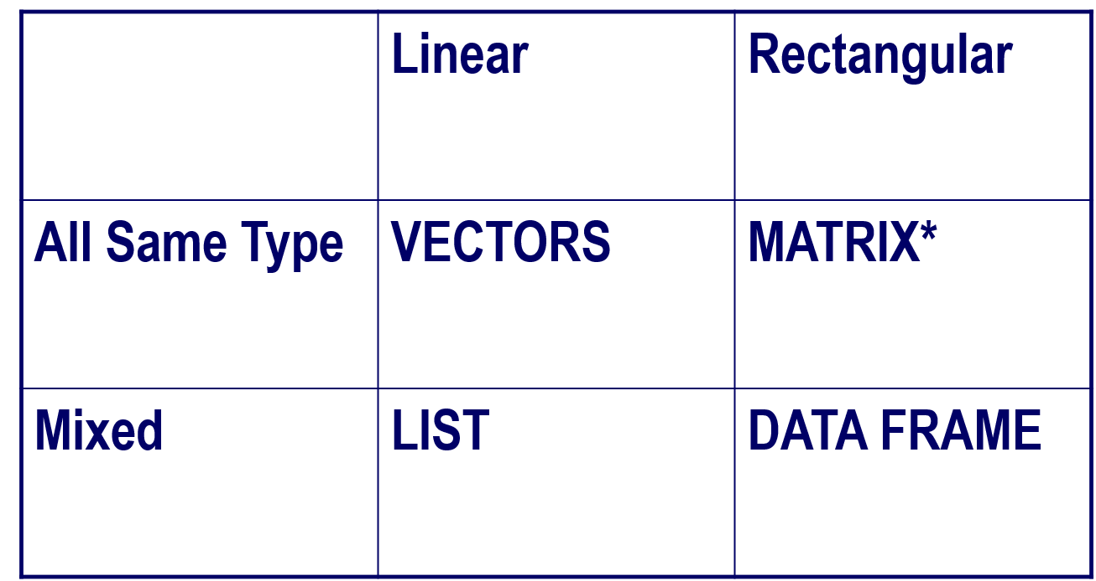
Data Structure in “R”
Chinmai sai Sure

Slide 10
Reading Data: Summary
Directly using a vector e.g: x <-c(1,2,3) .
Using scan and read.table function.
Using matrix function to read data matrices.
Using data.frame to read mixed data
Library(foreign) for data from other program.
Chinmai sai Sure

Slide 11
Statistical Functions in R
Descriptive Statistics
Statistical Modeling
Multivariate Functions
Chinmai sai Sure

Slide 12
Descriptive Statistics
Has functions for all common statistics.
Summary() gives lowest, mean, median, first, third quartiles, highest for numeric variables.
Steam() gives steam-leaf plots.
Table() gives tabulation of categorical variables.
Chinmai sai Sure

Slide 13
Statistical Modelling
Over 400 functions.
-lm, glm, aov, ts
Numerous libraries & packages
- Survival, coxph, tree(recursive trees),nls, …
Use of data.frame makes life easy
Chinmai sai Sure

Slide 14
Multi-Variate Techniques
Several Libraries available
- mva, hmisc,glm
- MASS: discriminant analysisand multidim scaling
Econometric packages
- dse (multi-varient time series, state-space models)
Chinmai sai Sure

Slide 15
Pro’s and Con’s of “R”
Pro’s
- Free and Open source.
- Strong user community.
- Highly extensible and flexible.
- implementation of high and statistical methods.
Con’s
- Steep learning curve.
- Slow for large datasets.
Chinmai sai Sure

Slide 16
Summary
Effective data handling and data storage.
Large, coherent set of tools for data analysis
Good graphical facilities and display
- on screen
- on paper
Well-developed, simple, effective programming.
Chinmai sai Sure

Slide 17
THANK YOU

